Slide 2
Objectives
Understand how hardware, firmware and an operating system are required to run applications
Understand the role of the bootloader
Describe the role and operation of interrupts including:
How an interrupt is generated
How it is handled using an interrupt service routine
What happens as a result of the interrupts
Be able to describe examples of software and hardware interrupts

Slide 3
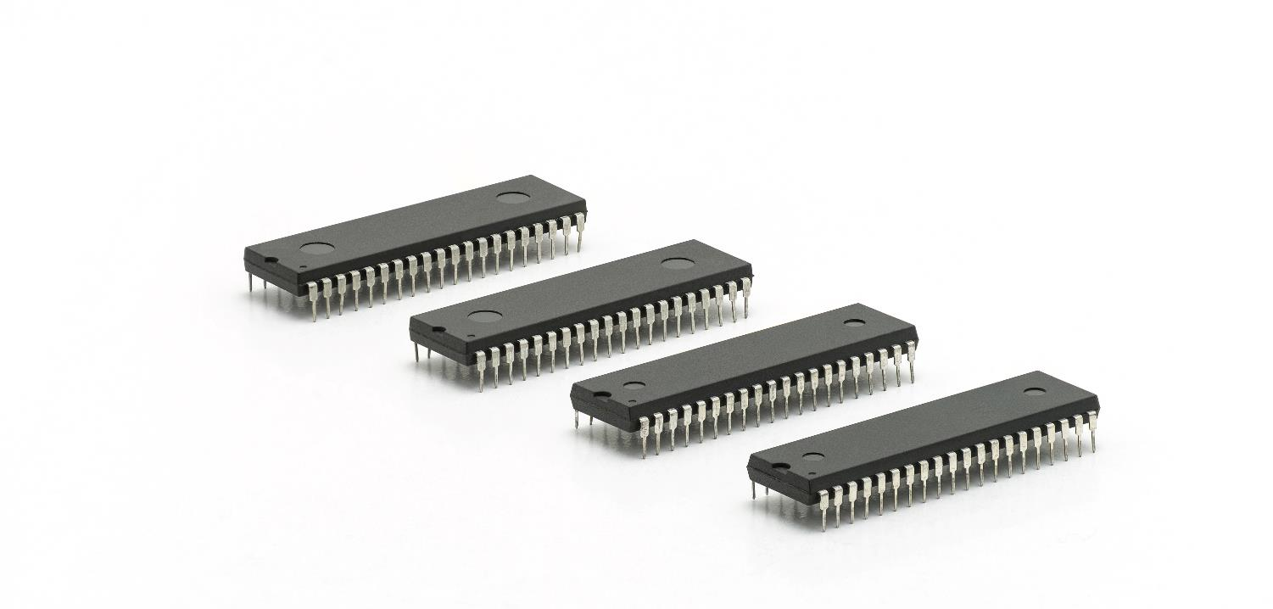

Starter
ROM on a computer stores programs that cannot be changed as they are stored on Read Only Memory
Are these programs software or hardware?
Discuss your thoughts with a partner

Slide 4
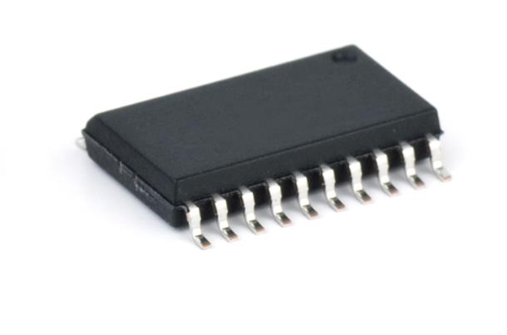
Firmware
Hardware is named after the fact it is physically hard
The term is used for all physical components of a computer or peripherals
Software isn’t a physical object, so it is given the opposite name (soft rather than hard)
Firmware (between hard and soft) contains programs that are stored permanently in hardware
The BIOS stored on a computer is stored on a flash ROM
It can only be updated by flashing the ROM
Other peripherals may have their own firmware

Slide 5

Bootloader
When you first turn on a computer it starts running firmware stored in the ROM
These instructions then load the first instructions from the hard disk telling the computer what tasks to do
The part of the hard disk that stores these instructions is the boot sector
Turning on a computer is known as ‘booting’ after “pulling yourself up by your bootstraps”

Slide 6
Running applications
Applications run on the computer’s operating system
If they need to access hardware, they do this via ‘calls’ to the operating system or device drivers
The operating system itself runs on top of the firmware
The bootloader and other firmware runs on the physical hardware itself
Applications
Operating system
Firmware
Hardware

Slide 7
Worksheet 3
Complete Task 1 on Worksheet 3

Slide 8
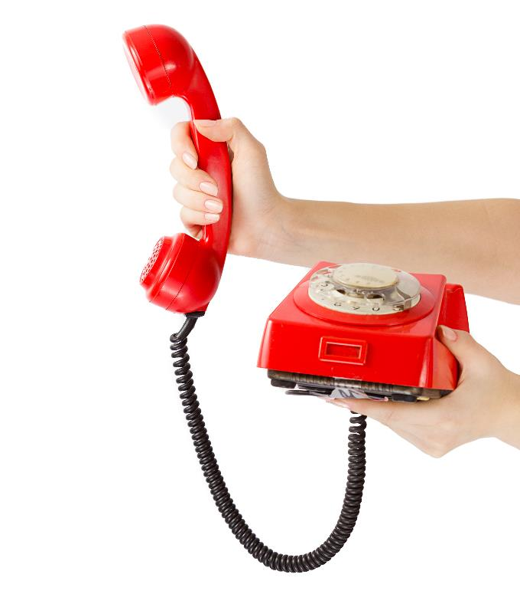
Interrupts
When you need to get the attention of someone who is busy you need to interrupt them
In the same way, peripheral devices also need to get the attention of the CPU
They do this by sending an interrupt which leads to the relevant interrupt service routine (ISR) being run
What happens to the current process that is running on the processor?

Slide 9
Interrupts
The current process will need to pause, but it will need to be restarted later
The value stored in the program counter (PC) is saved in a location in RAM
No more instructions of the following task are performed (they will be later)

Slide 10
Interrupt Service Routine (ISR)
Once the CPU has been interrupted, it needs to process the interrupt
It runs the interrupts program code known as an Interrupt Service Routine (ISR)
This is also known as an interrupt handler
The ISR needs to execute as quickly as possible as it has interrupted the CPU from the task it was working on
For instance, if a key is pressed, the ISR may save the key that was pressed. Later, a word-processor task can process it further
Interrupt service routine (ISR)
Interrupt generated
Processor returns to previous task

Slide 11
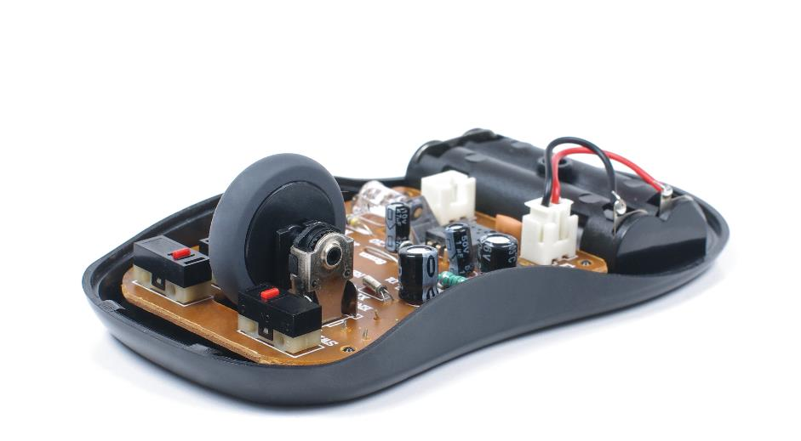
Hardware interrupts
Hardware devices send interrupt signals to the CPU
The interrupts are sent via Interrupt Request Lines (IRQ)
For instance, if a key on a keyboard is pressed, an interrupt will be sent (actually an interrupt is sent when the key is pressed and another is sent when it is released)
When a mouse is moved, constant interrupts are sent to the computer so that it is able to update the location of the pointer

Slide 12

Software interrupts
Software interrupts are generated by programs that are running
For instance, if a program tries to divide by zero, a ‘division by zero’ interrupt will need to be handled
In this case, an exception is handled by the OS

Slide 13
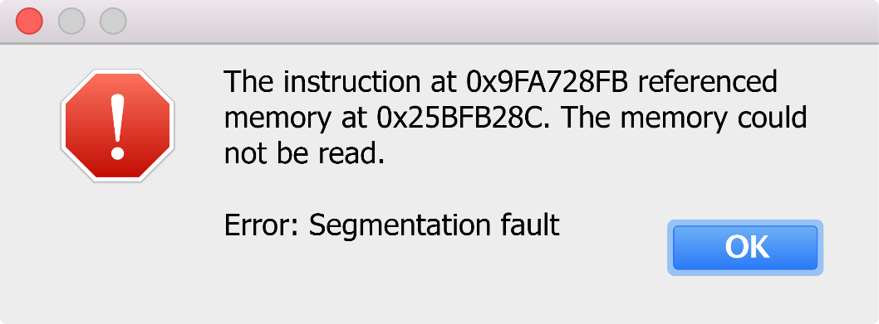
Software interrupts
Software interrupts deal with faults such as:
Page faults – this is when the data isn’t in RAM, but in virtual memory and needs to be loaded back into RAM
Segmentation faults – this is when the one program tries to make an illegal memory location, such as the memory used by another program
When a fault occurs an interrupt service routine is called which handles the error

Slide 14
Worksheet 2
Complete Task 2 on Worksheet 3

Slide 15
Plenary
Take turns to explain to a partner each of the following terms
Bootloader
Firmware
Interrupt
Interrupt service routine (ISR)
Software interrupt
Hardware interrupt

Slide 16
Plenary
Bootloader – the first instructions a computer runs that tell it where to find the boot sector on the hard drive. The bootloader is stored in the ROM’s firmware
Firmware – programs stored in ROM
Interrupt – A signal sent to a processor causing it to pause the current task and handle the interrupt
Hardware interrupt – interrupts generated by hardware, such as a key press or mouse movement
Software interrupt – interrupts generated by software, such as an attempted division by zero or an attempt to access a memory location currently being used by another program
Interrupt service routine – a short set of instructions that is executed when an interrupt occurs – also known as an interrupt handler

